Slide 1

Medical Image Seminar
Yicheng Jiang
CUHK, Shenzhen
Mar 26, 2020
Notes:
The IEEE International Symposium on Biomedical Imaging (ISBI)
[sɪmˈpoʊziəm]

Slide 2
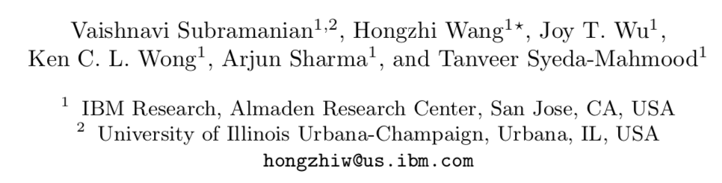
Paper Information
TITLE
Automated Detection and Type Classification of Central Venous Catheters in Chest X-rays
Authors
Cite paper as: Subramanian V., Wang H., Wu J.T., Wong K.C.L., Sharma A., Syeda-Mahmood T. (2019) Automated Detection and Type Classification of Central Venous Catheters in Chest X-Rays. In: Shen D. et al. (eds) Medical Image Computing and Computer Assisted Intervention – MICCAI 2019. MICCAI 2019. Lecture Notes in Computer Science, vol 11769. Springer, Cham
Notes:
The IEEE International Symposium on Biomedical Imaging (ISBI)
[sɪmˈpoʊziəm]

Slide 3
Background
Central Venous Catheters (CVCs)
Central venous catheters (CVCs) are commonly used in critical care settings and surgeries to monitor a patient’s heart function and deliver medications close to the heart. These are inserted centrally or peripherally through the jugular, subclavian or brachial veins and advanced towards the heart through the venous system, most often blindly.
The manual interpretation of the CXRs after the CVC placements is used to rule out malpositioning and complications.
Notes:
The IEEE International Symposium on Biomedical Imaging (ISBI)
[sɪmˈpoʊziəm]

Slide 4
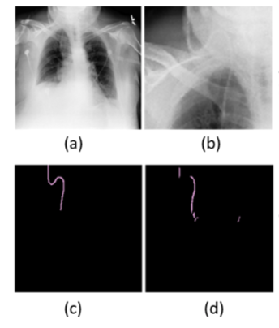
Problem
Target
Simultaneously and automatically address the detection and classification of the CVC type on a large public CXR dataset
Meaning
Considerably expedite the clinical workflow for future automatically radiology reports
Type classification
Difficulties
Different types of CVCs also have slightly different optimal tip locations.
Thin tubular structures that occupy less than 1% of the footprint in the overall image => bad results from direct detection and recognition through whole image
Figure: (a) Original CXR where the CVC is barely visible, (b) enlarged region of interest focusing on the CVC, (c) manual CVC annotation, (d) segmentation produced by U- Net
Notes:
The IEEE International Symposium on Biomedical Imaging (ISBI)
[sɪmˈpoʊziəm]

Slide 5
Previous Method
Lee, H. (2017). et al[1]: 2 FCNs for PICC line and Tip ROI, output PICC tip. Only for 1 type of CVCs, which is PICC.
Ambrosini, P. (2017) et al.[2]: U-net. Small size of dataset and no classification
Yi, X. (2019). et al[3]: Scale RNN. Only segmentation for Synthetic data
Notes:
The IEEE International Symposium on Biomedical Imaging (ISBI)
[sɪmˈpoʊziəm]

Slide 6
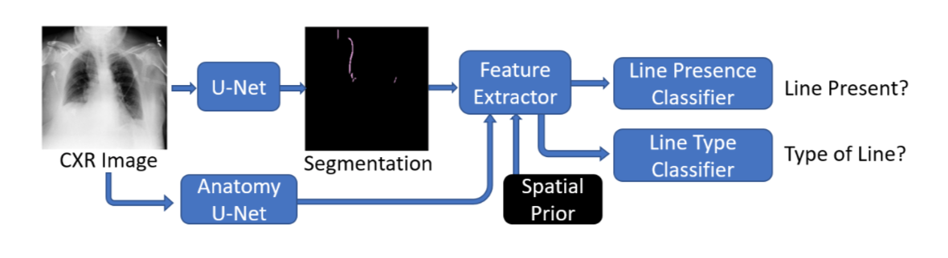
Method
Structure
Input & Output
Input: Original CXR Image & Spatial Prior
Output: If Line Present & Type of Line
Notes:
The IEEE International Symposium on Biomedical Imaging (ISBI)
[sɪmˈpoʊziəm]

Slide 7
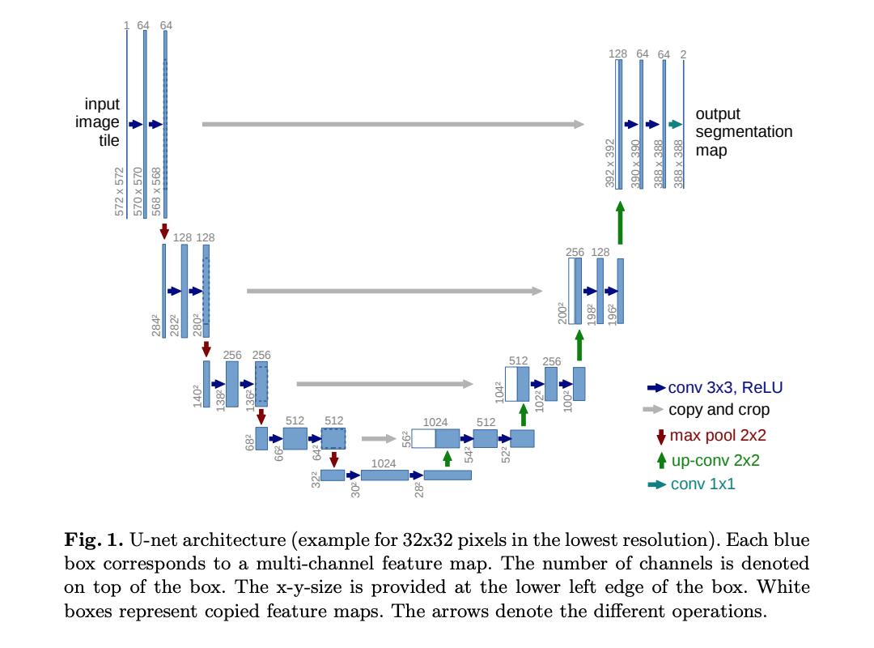
Method
Segmentation
Modified U-Net: U-Net[4] + Exponential Logarithmic Loss Function[5]
U-NET:
Figure cited from [4]
Notes:
The IEEE International Symposium on Biomedical Imaging (ISBI)
[sɪmˈpoʊziəm]

Slide 8
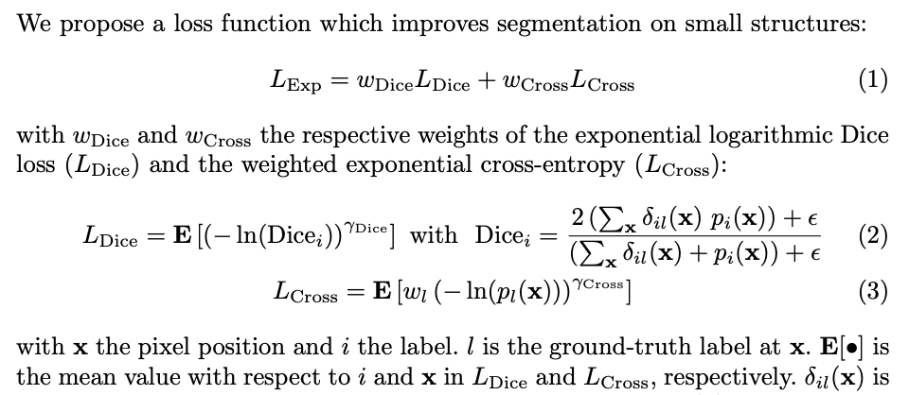
Method
Segmentation
Modified U-Net: U-Net[4] + Exponential Logarithmic Loss Function[5]
Loss Function:
the best-performing weights w_{Dice} = 0.8 and w_{Cross} = 0.2
Figure cited from [5]
Notes:
The IEEE International Symposium on Biomedical Imaging (ISBI)
[sɪmˈpoʊziəm]

Slide 9
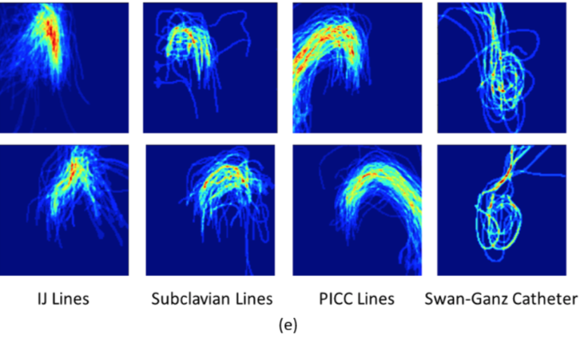
Method
Feature Extraction
Spacial prior for each class + Relation to anatomical features + Size and shape properties
1. Spacial prior for each class:
Average the manual annotations per-pixel for each class and blur them spatially to obtain signature spatial priors for each of the CVC classes
Figure(e): The pixel-wise overlay of manual annotations for four common types of CVCs, which are used to construct spatial priors.
Notes:
The IEEE International Symposium on Biomedical Imaging (ISBI)
[sɪmˈpoʊziəm]

Slide 10
Method
Feature Extraction
Spacial prior for each class + Relation to anatomical features + Size and shape properties
2. Relation to anatomical features:
Extract the segmentation of chest anatomical structures including the clavicles, lungs, heart and mediastinum using an independent U-Net again trained on clinician annotations.
3. Size and shape properties:
Characterize the shape and size properties of the positive regions of segmentation: the area, length and width characterize the overall presence/absence of CVCs, the histogram of oriented gradients (HoG) describe the shape contours which are crucial for type classification.
Notes:
The IEEE International Symposium on Biomedical Imaging (ISBI)
[sɪmˈpoʊziəm]

Slide 11
Method
Classification with Random Forest
Employ a random forest (RF) for each task.
The first RF yields a binary presence/absence label.
The second provides a multi-label output, with 4 indicators, one for each type of CVC: PICC, IJ, subclavian and Swan-Ganz.
Notes:
The IEEE International Symposium on Biomedical Imaging (ISBI)
[sɪmˈpoʊziəm]

Slide 12
Data
Totally 112,000 CXRs from NIH dataset, U.S National Library of Medicine
The related dataset has been released as part of the MICCAI 2019 Multimodal Learning for Clinical Decision Support (ML-CDS) Challenge.
http://www.mcbr-cds.org/challenge/challenge-data.html
Notes:
The IEEE International Symposium on Biomedical Imaging (ISBI)
[sɪmˈpoʊziəm]

Slide 13
Data
CVC Segmentation - Pixel level annotation
A random sample of 1500 CXRs from NIH were annotated at the pixel level.
359 IJ + 78 Subclavian + 277 PICC + 32 Swan-Ganz
A total of 608 annotated images of size 512 x 512.
The remaining images have no lines.
80% training and 20% validation for Segmentation
Notes:
The IEEE International Symposium on Biomedical Imaging (ISBI)
[sɪmˈpoʊziəm]

Slide 14
Data
CVC Presence - Whole image level annotation
A subset of 3000 images fromNIH.
A radiologist labeled globally for presence of external medical devices.
2381 CXRs with some device present, and 619 CXRs with an absence of any device.
5-fold cross-validation using a 60-20-20 split for training-validation-testing
=> CVC Presence Identification
Notes:
The IEEE International Symposium on Biomedical Imaging (ISBI)
[sɪmˈpoʊziəm]

Slide 15
Data
CVC Type - Whole image level annotation
A subset of around 16,000 CXRs from NIH were labeled by a group of radiologists
10,746 CXRs with at least one type of externally inserted catheter:
4249 PICC + 1651 IJ + 201 Subclavian +192 Swan- Ganz + 4453 Other catheters, including airway and drainage tubes
5-fold cross-validation using a 60-20-20 split for training-validation- testing
=> CVC Type Identification
Notes:
The IEEE International Symposium on Biomedical Imaging (ISBI)
[sɪmˈpoʊziəm]

Slide 16
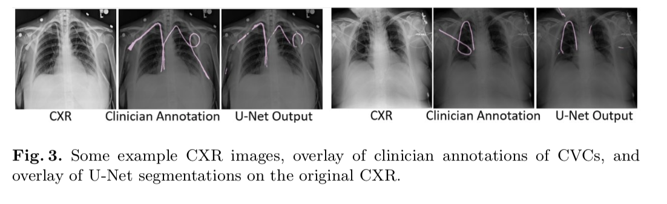
Result
Segmentation
Notes:
The IEEE International Symposium on Biomedical Imaging (ISBI)
[sɪmˈpoʊziəm]

Slide 17
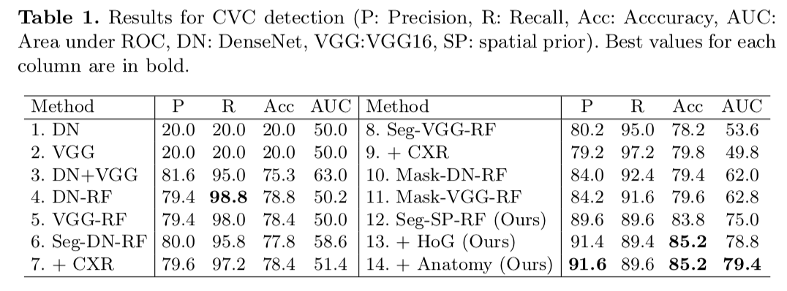
Result
CVC Presence Identification
Notes:
The IEEE International Symposium on Biomedical Imaging (ISBI)
[sɪmˈpoʊziəm]

Slide 18
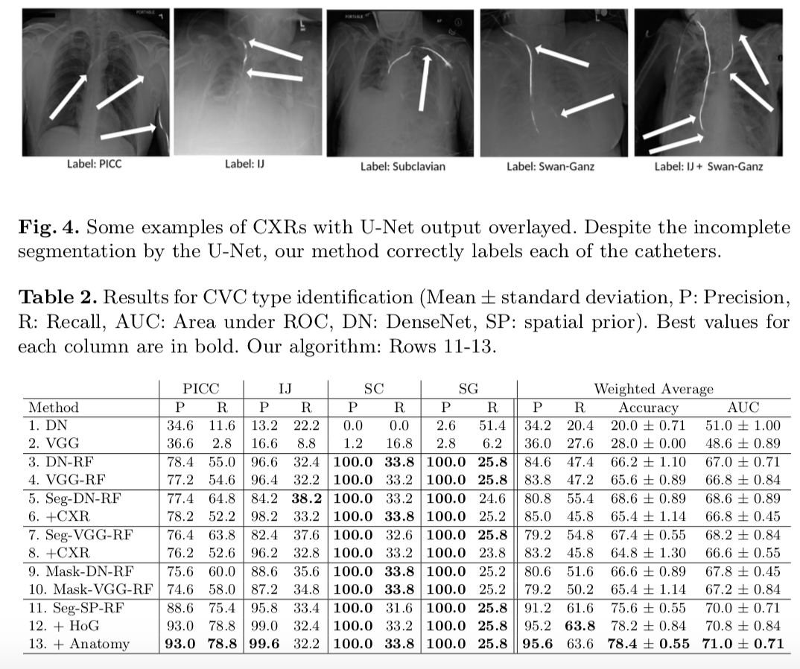
Result
CVC Type Identification
Notes:
The IEEE International Symposium on Biomedical Imaging (ISBI)
[sɪmˈpoʊziəm]

Slide 19
Conclusion
A large labelled dataset is provided.
First time for simultaneous detection and classification of CVCs
A robust solution (spatial prior)
Notes:
The IEEE International Symposium on Biomedical Imaging (ISBI)
[sɪmˈpoʊziəm]

Slide 20
References
[1] Lee, H., Mansouri, M., Tajmir, S., Lev, M.H., Do, S.: A deep-learning system for fully-automated peripherally inserted central catheter (PICC) tip detection. Journal of digital imaging pp. 1–10 (2017)
[2] Ambrosini, P., Ruijters, D., Niessen, W.J., Moelker, A., van Walsum, T.: Fully au- tomatic and real-time catheter segmentation in X-ray fluoroscopy. In: International Conference on Medical Image Computing and Computer-Assisted Intervention. pp. 577–585. Springer (2017)
[3] Yi, X., Adams, S., Babyn, P., Elnajmi, A.: Automatic catheter and tube detection in pediatric x-ray images using a scale-recurrent network and synthetic data. Journal of digital imaging pp. 1–10 (2019)
[4] Ronneberger,O.,Fischer,P.,Brox,T.:U-net:Convolutionalnetworksforbiomedical image segmentation. In: International Conference on Medical image computing and computer-assisted intervention. Springer (2015)
[5] Wong, K.C., Moradi, M., Tang, H., Syeda-Mahmood, T.: 3D segmentation with exponential logarithmic loss for highly unbalanced object sizes. In: International Conference on Medical Image Computing and Computer-Assisted Intervention. pp. 612–619. Springer (2018)
Notes:
The IEEE International Symposium on Biomedical Imaging (ISBI)
[sɪmˈpoʊziəm]

Slide 21
Thank You!
Notes:
The IEEE International Symposium on Biomedical Imaging (ISBI)
[sɪmˈpoʊziəm]

